Slide 1
United Airlines Time Recovery Analysis: NYC Departures (2013)
Project 2 Presentation
DATA 5300

Slide 2



Introduction
Analyzed United Airlines (UA) departing flights from NYC airports in 2013
Our goal: Understand how flights recover time en route
We focused on two measures: net gain and gain per hour

Slide 3
Data Methodology
Late and Very Late
Gain
Destination Airports
Gain Per Hour
Short vs Long Flights

Slide 4
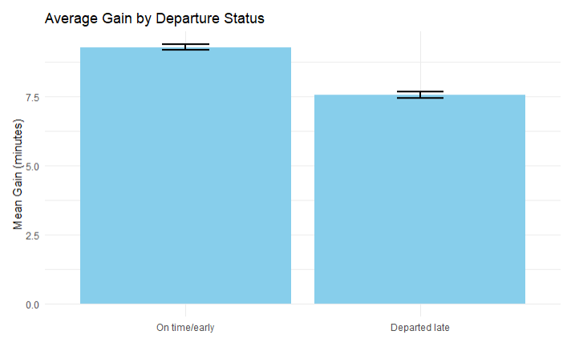
Does the average gain differ for flights that departed late versus those that did not?
Degree of Freedom | T-Statistic | P-Value | 95% Confidence Interval
52833 | 10.749 | 2.2e-16 | (1.411, 2.04)
Notes:
Figure 1 compares the average gain for flights that departed on time with those that departed late. Flights leaving early or on time gained an average of 9.3 minutes, while late-departing flights gained 7.5 minutes on average. To assess whether this difference is statistically meaningful, a two-sample t-test with unequal variances was conducted (Table 1). The test produced a p-value of 2.2e-16 and a 95% confidence interval for the difference of (1.411, 2.04). Although the difference is statistically significant, its magnitude is small.

Slide 5
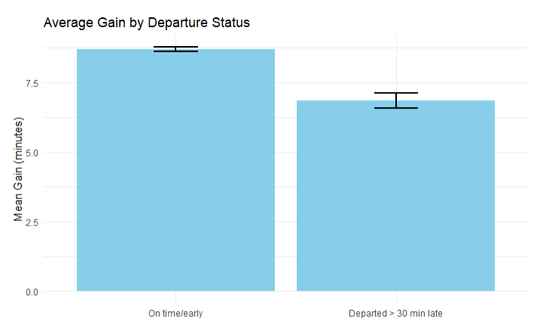
Does the average gain differ for flights that departed very late versus those that did not?
Degree of Freedom | T-Statistic | P-Value | 95% Confidence Interval
8838.6 | 6.2953 | 3.215e-10 | (1.268, 2.415)
Notes:
Figure 2 displays the average gain for flights that departed early, on-time, or slightly late compared with those that departed very late (by more than 30 minutes). Flights that departed very late gained 6.8 minutes on average whereas those did not gained 8.7 minutes. A two-sample t-test assuming unequal variances was used to evaluate the significance of this difference. The test yielded a p-value of 3.215e-10 and a 95% confidence interval of (1.268, 2.415). These results indicate that, while the difference in gain between the two groups is statistically significant, it is practically quite small.

Slide 6
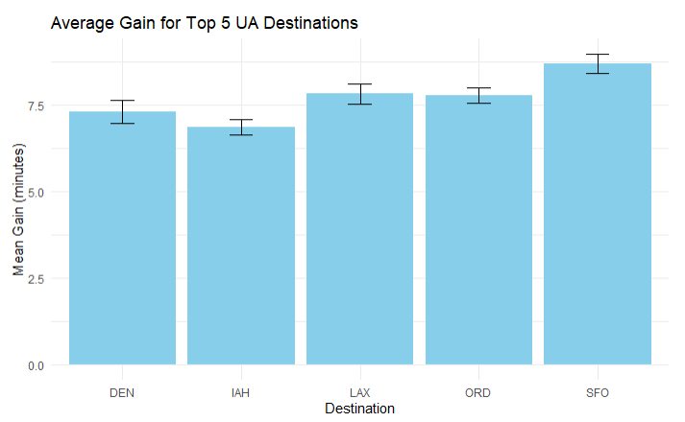
Most common destination airports for United Airlines flights from New York City
Destination | Number of Flights | Mean Gain (minutes) | SD Gain
IAH | 6814 | 6.861 | 18.44
ORD | 6744 | 7.777 | 19.15
SFO | 6728 | 8.695 | 22.40
LAX | 5770 | 7.825 | 21.91
DEN | 3737 | 7.302 | 20.04

Slide 7
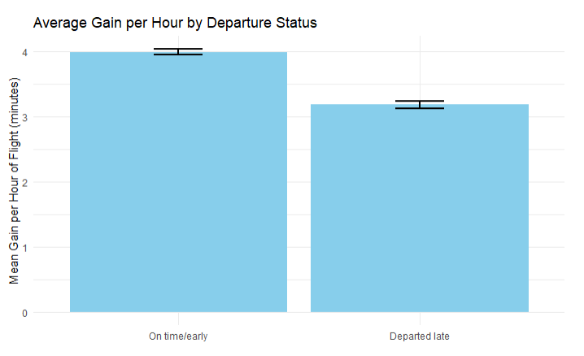
Does the average gain per hour differ for flights that departed late versus those that did not?
Degree of Freedom | T-Statistic | P-Value | 95% Confidence Interval
53125 | 11.285 | 2.2e-16 | (0.666, 0.946)
Notes:
Figure 4 shows the average gain per hour for flights that departed late and those that did not. On average, flights that departed on time gained 3.99 minutes per hour whereas late departures gained 3.184 minutes. Due to concern regarding the normality of the gain per hour variable, both regular and bootstrap t tests were conducted. However, the resulting 95% confidence intervals of the difference in means agree (Table 4) with both suggesting that there is a statistically significant yet negligible difference in gain per hour between on-time and late departures.

Slide 8
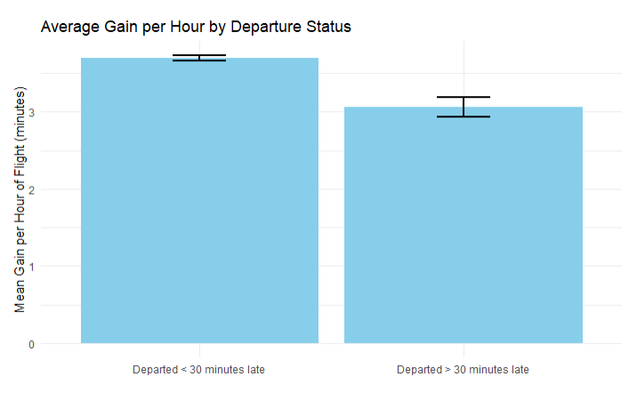
Does the average gain per hour differ for flights that departed very late versus those that did not?
Degree of Freedom | T-Statistic | P-Value | 95% Confidence Interval
8835.1 | 4.8323 | 1.372e-06 | (0.3745, 0.8858)
Notes:
Figure 5 compares average gain for flights departing on time versus those departing late. Early, on-time, or slightly late departures showed an average gain of 3.7 minutes per hour, while late departures averaged 3.06 minutes. A two-sample t-test with unequal variances was used to test the difference, producing a p-value of 1.372e-06 and a 95% confidence interval of (0.3745, 0.8858). These results confirm a statistically significant difference in gain between the groups, though the size of the difference is minimal.

Slide 9
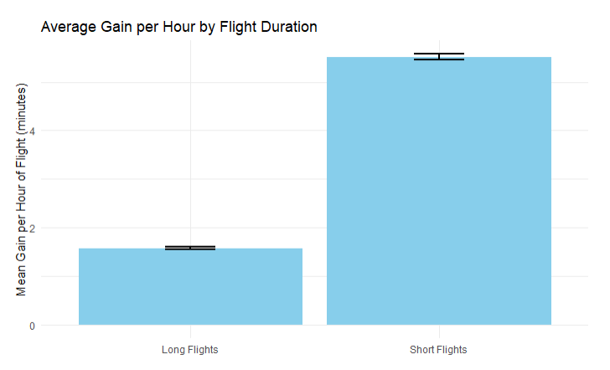
Does the average gain per hour differ for short and long flights?
Degree of Freedom | T-Statistic | P-Value | 95% Confidence Interval
40524 | -58.677 | 2.2e-16 | (-4.07, -3.8)
Notes:
On average, long flights (> 200 minutes) tend to have a lower gain of 1.576 minutes per hour whereas shorter flights have a gain of 5.515 minutes per hour (Figure 6). A Two sample t-test confirms the significance of this difference with a P-Value of 2.2e-16.

Slide 10



Discussion and Insights
On time flights tend to have a better gain
Recovery varies by route
Short flights recover slightly more per hour
Useful for scheduling and forecasting

Slide 11


Potential Next Steps
INCORPORATE WEATHER AND SEASONAL CONDITIONS BASED ON PROJECT 1
EXAMINE CONGESTION EFFECTS AT VARIOUS AIRPORTS
MODEL ROUTE-LEVEL DIFFERENCES

